Slide 1
L04 Binomial Distribution
Concepts
E214 – Statistical Methods for Engineering

Slide 2
E214 – Statistical Methods for Engineering
Inferential Statistics
Hypothesis Testing
Parameter Estimation
Organise & summarise data collected
Probability and Distributions
Venn Diagram
Probability Distributions
Descriptive Statistics
Tree Diagram
Discrete Random Variables and Probability Distributions
Continuous Random Variables and Probability Distributions
Binomial Distribution
Poisson Distribution
Normal Distribution
Exponential Distribution
A more detailed topic tree on Hypothesis Testing will be given from L08 onwards
L04

Slide 3
Overview of Concepts
S/N | Concepts | Slide Number
1 | Combination | 4-5
2 | Bernoulli Trial | 6
3 | Binomial Experiment | 7-8
4 | Binomial Random Variable and Distribution | 9-11
5 | Calculation of Probabilities using Excel | 12-13
6 | Shape of Binomial Distribution Graph | 14
7 | Mean, Variance, Standard Deviation, Mode of Binomial Random Variable | 15-18
8 | Summary of learning objectives for L04 | 19
9 | E-learning video for L04 | 20

Slide 4
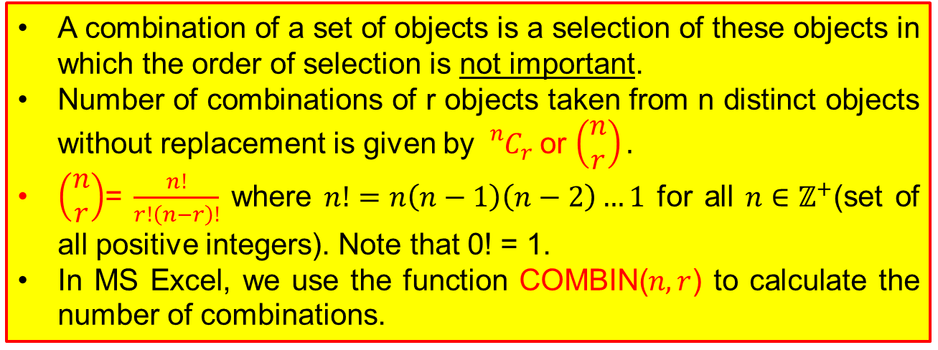
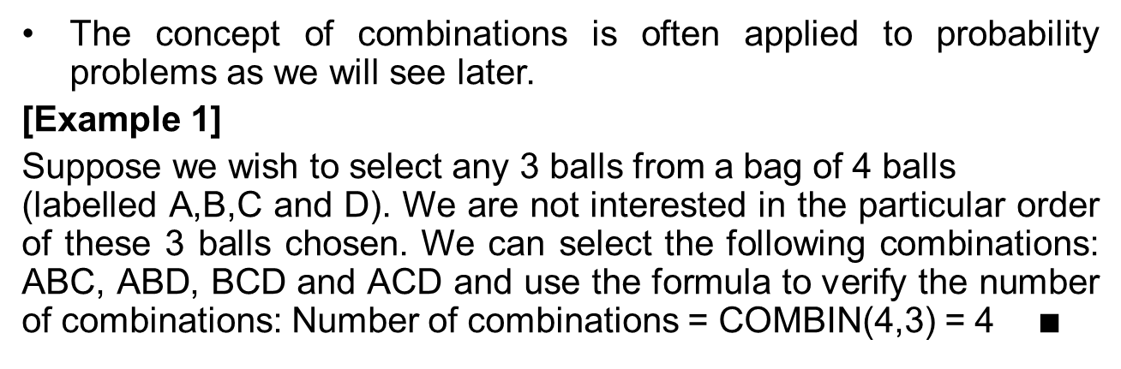
Combination
A combination of a set of objects is a selection of these objects in which the order of selection is not important.
Number of combinations of r objects taken from n distinct objects without replacement is given by ${{}_{}^{n}C}_{r}$or $\left(\begin{matrix}n \\ r\end{matrix}\right).$
$\left(\begin{matrix}n \\ r\end{matrix}\right)$= $\frac{n!}{r!\left(n−r\right)!}$ where $n!=n\left(n−1\right)\left(n−2\right)…1$ for all $n∈ℤ^{+}$(set of all positive integers). Note that 0! = 1.
In MS Excel, we use the function COMBIN($n,r$) to calculate the number of combinations.
The concept of combinations is often applied to probability problems as we will see later.
[Example 1]
Suppose we wish to select any 3 balls from a bag of 4 balls (labelled A,B,C and D). We are not interested in the particular order of these 3 balls chosen. We can select the following combinations: ABC, ABD, BCD and ACD and use the formula to verify the number of combinations: Number of combinations = COMBIN(4,3) = 4 $∎$

Slide 5
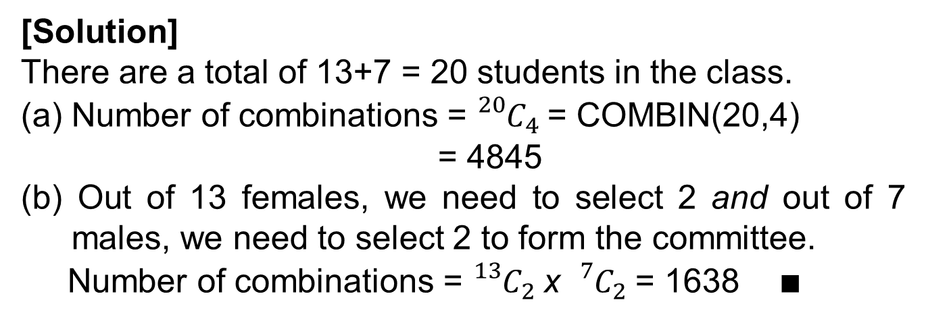
Combination
[Example 2]
There are 13 female and 7 male students in a class.
A 4-member committee is to be selected. In how many ways can the committee be selected if
(a) there is no restriction to the selection,
(b) there must be 2 females and 2 males in the committee?
[Solution]
There are a total of 13+7 = 20 students in the class.
(a) Number of combinations = ${{}_{}^{20}C}_{4}$= COMBIN(20,4)
= 4845
(b) Out of 13 females, we need to select 2 and out of 7 males, we need to select 2 to form the committee.
Number of combinations = ${{}_{}^{13}C}_{2}$x ${{}_{}^{7}C}_{2}$= 1638 $∎$

Slide 6
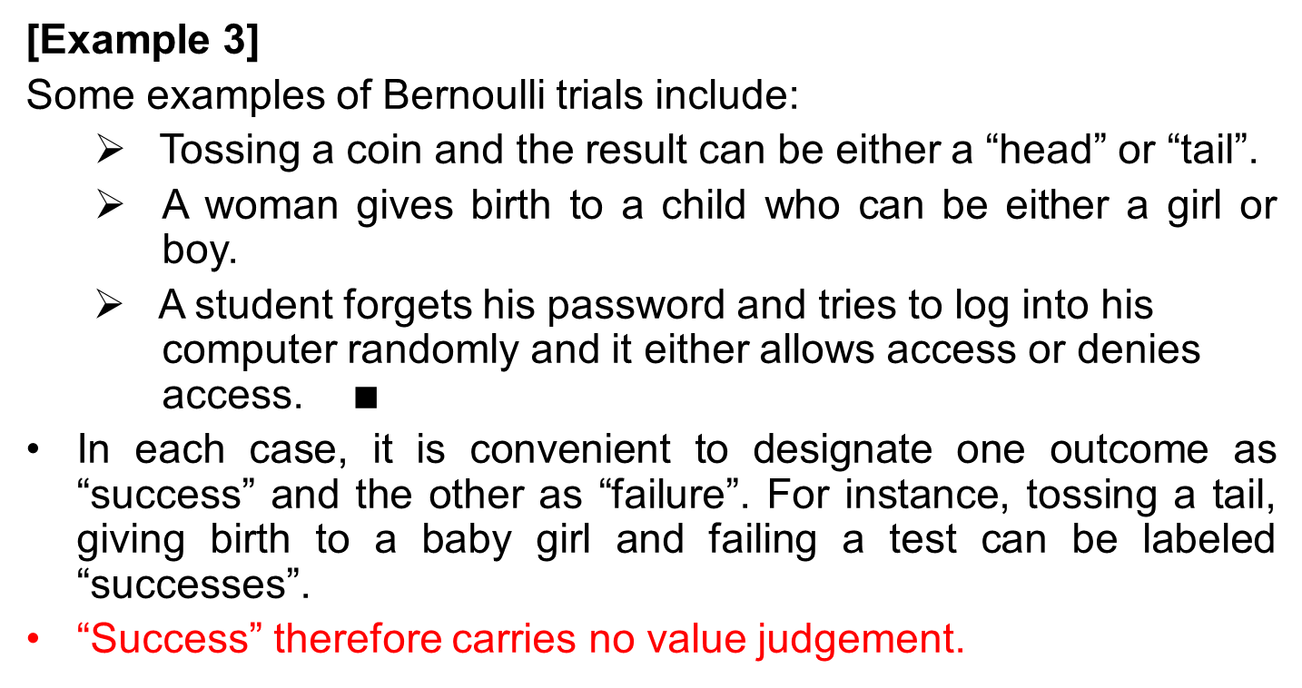
Bernoulli Trial
A Bernoulli trial is a single random experiment in which there are only two possible outcomes, conventionally called “success” or “failure”.
[Example 3]
Some examples of Bernoulli trials include:
Tossing a coin and the result can be either a “head” or “tail”.
A woman gives birth to a child who can be either a girl or boy.
A student forgets his password and tries to log into his computer randomly and it either allows access or denies access. $∎$
In each case, it is convenient to designate one outcome as “success” and the other as “failure”. For instance, tossing a tail, giving birth to a baby girl and failing a test can be labeled “successes”.
“Success” therefore carries no value judgement.

Slide 7
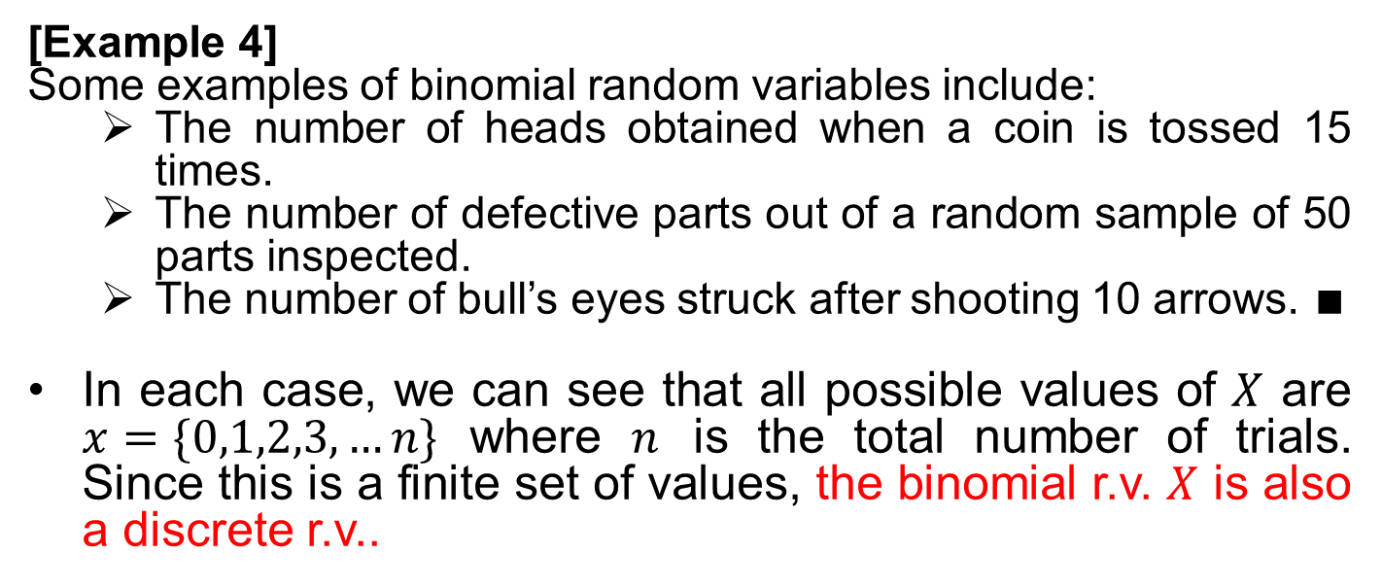
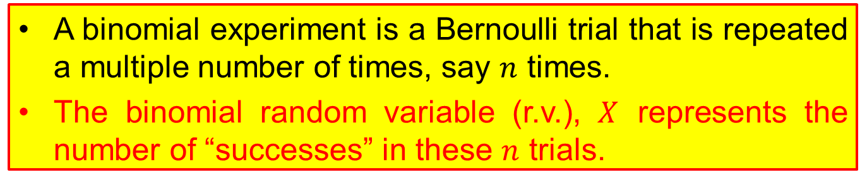
Binomial Experiment
A binomial experiment is a Bernoulli trial that is repeated a multiple number of times, say $n$ times.
The binomial random variable (r.v.), $X$ represents the number of “successes” in these $n$ trials.
[Example 4]
Some examples of binomial random variables include:
The number of heads obtained when a coin is tossed 15 times.
The number of defective parts out of a random sample of 50 parts inspected.
The number of bull’s eyes struck after shooting 10 arrows. $∎$
In each case, we can see that all possible values of $X$ are $x=\{0,1,2,3,…n\}$ where $n$ is the total number of trials. Since this is a finite set of values, the binomial r.v. $X$ is also a discrete r.v..

Slide 8
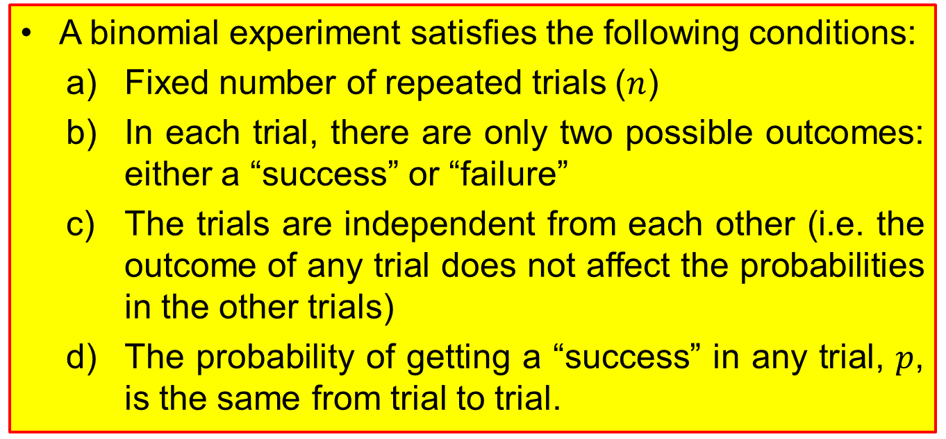
Conditions of a Binomial Experiment
A binomial experiment satisfies the following conditions:
Fixed number of repeated trials ($n$)
In each trial, there are only two possible outcomes: either a “success” or “failure”
The trials are independent from each other (i.e. the outcome of any trial does not affect the probabilities in the other trials)
The probability of getting a “success” in any trial, $p$, is the same from trial to trial.

Slide 9
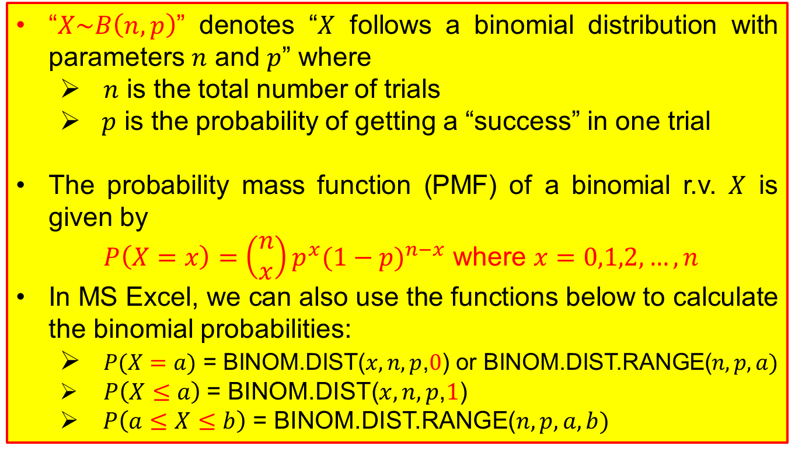
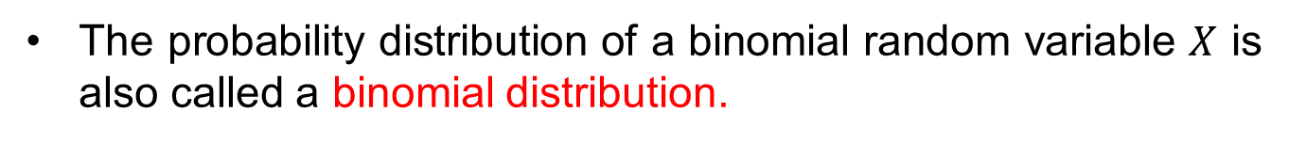
Binomial Random Variable and Distribution
The probability distribution of a binomial random variable $X$ is also called a binomial distribution.
“$X\sim B\left(n,p\right)$” denotes “$X$ follows a binomial distribution with parameters $n$ and $p$” where
$n$ is the total number of trials
$p$ is the probability of getting a “success” in one trial
The probability mass function (PMF) of a binomial r.v. $X$ is given by
$P\left(X=x\right)=\left(\begin{matrix}n \\ x\end{matrix}\right)p^{x}{(1−p)}^{n−x}$ where $x=0,1,2,…,n$
In MS Excel, we can also use the functions below to calculate the binomial probabilities:
$P(X=a)$ = BINOM.DIST($x,n,p$,$0$) or BINOM.DIST.RANGE($n,p,a)$
$P\left(X≤a\right)$= BINOM.DIST($x,n,p$,$1$)
$P\left(a≤X≤b\right)$ = BINOM.DIST.RANGE($n,p,a,b)$

Slide 10
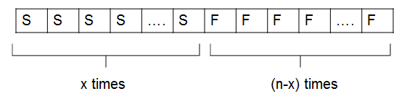
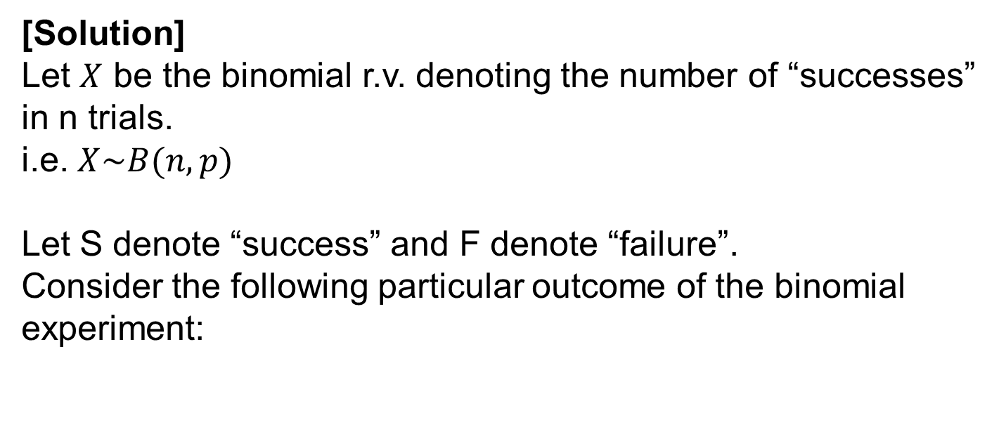
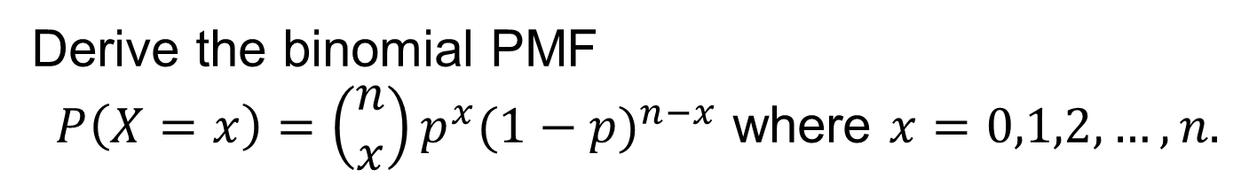
Example 5
Derive the binomial PMF
$P\left(X=x\right)=\left(\begin{matrix}n \\ x\end{matrix}\right)p^{x}{(1−p)}^{n−x}$ where $x=0,1,2,…,n.$
[Solution]
Let $X$ be the binomial r.v. denoting the number of “successes” in n trials.
i.e. $X\sim B(n,p)$
Let S denote “success” and F denote “failure”.
Consider the following particular outcome of the binomial experiment:

Slide 11
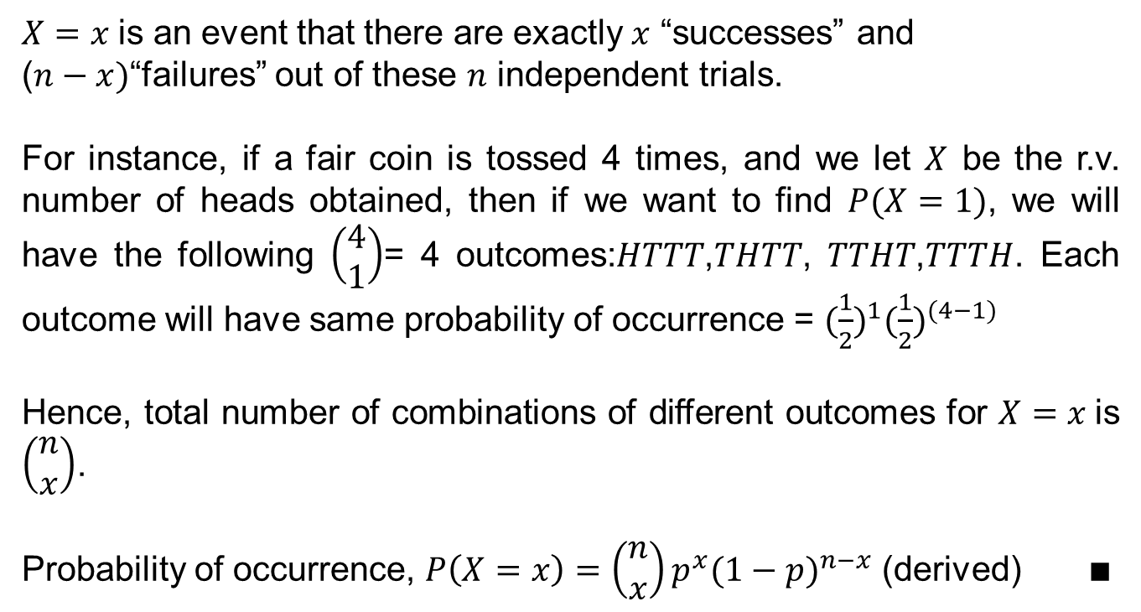
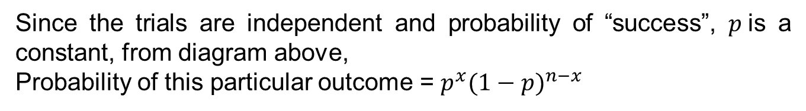
Example 5
Since the trials are independent and probability of “success”, $p$is a constant, from diagram above,
Probability of this particular outcome = $p^{x}{(1−p)}^{n−x}$
$X=x$is an event that there are exactly $x$ “successes” and
($n−x)$“failures” out of these $n$ independent trials.
For instance, if a fair coin is tossed 4 times, and we let $X$ be the r.v. number of heads obtained, then if we want to find $P(X=1)$, we will have the following $\left(\begin{matrix}4 \\ 1\end{matrix}\right)$= 4 outcomes:$HTTT$,$THTT$, $TTHT$,$TTTH$. Each outcome will have same probability of occurrence = ${(\frac{1}{2})}^{1}({\frac{1}{2})}^{(4−1)}$
Hence, total number of combinations of different outcomes for $X=x$is $\left(\begin{matrix}n \\ x\end{matrix}\right)$.
Probability of occurrence, $P\left(X=x\right)=\left(\begin{matrix}n \\ x\end{matrix}\right)p^{x}{(1−p)}^{n−x}$ (derived) $∎$

Slide 12
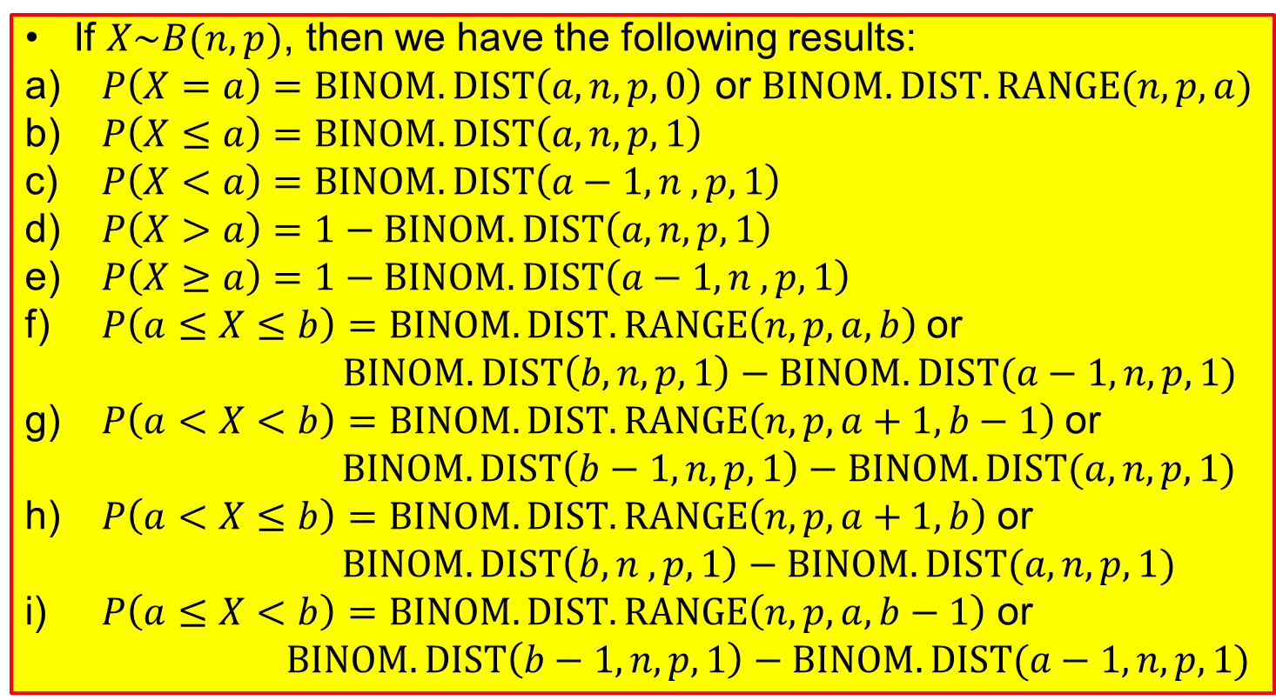
Calculation of Probabilities using Excel
If $X\sim B(n,p)$, then we have the following results:
$P\left(X=a\right)=BINOM.DIST\left(a,n,p,0\right)$ or $BINOM.DIST.RANGE(n,p,a)$
$P\left(X≤a\right)=BINOM.DIST\left(a,n,p,1\right)$
$P\left(X<a\right)=BINOM.DIST\left(a−1,n , p, 1\right)$
$P\left(X>a\right)=1−BINOM.DIST\left(a,n,p,1\right)$
$P\left(X≥a\right)=1−BINOM.DIST\left(a−1, n , p, 1\right)$
$P\left(a≤X≤b\right)=BINOM.DIST.RANGE\left(n,p,a,b\right)$ or
$BINOM.DIST\left(b, n, p, 1\right)−BINOM.DIST(a−1, n, p, 1)$
g) $P\left(a<X<b\right)=BINOM.DIST.RANGE\left(n,p,a+1, b−1\right)$ or
$BINOM.DIST\left(b−1, n, p, 1\right)−BINOM.DIST(a, n, p, 1)$
h) $P\left(a<X≤b\right)$ $=BINOM.DIST.RANGE\left(n,p,a+1,b\right)$ or
$BINOM.DIST\left(b, n , p, 1\right)−BINOM.DIST(a, n, p, 1)$
i) $P\left(a≤X<b\right)$ $=BINOM.DIST.RANGE\left(n,p,a,b−1\right)$ or
$BINOM.DIST\left(b−1, n, p, 1\right)−BINOM.DIST(a−1, n, p, 1)$
For detailed explanation of results, please refer to e-learning video with link in Slide 23.

Slide 13
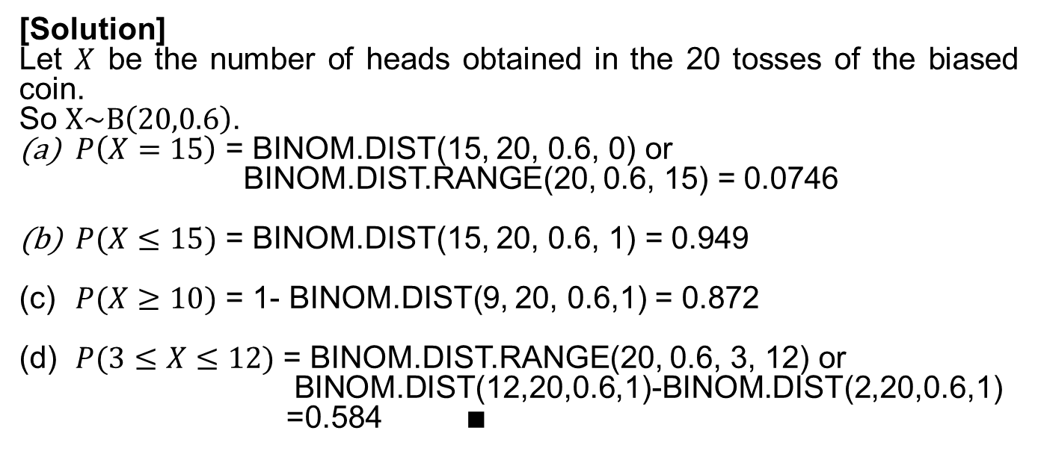
Example 6
A biased coin is tossed 20 times. The probability of getting a head in a toss is 0.6. Find the probability of getting:
(a) exactly 15 heads,
(b) at most 15 heads,
(c) at least 10 heads, and
(d) between 3 and 12 heads inclusive.
Problem Solving Framework
Define the random variable in the problem context.
State the distribution, with parameter values.
Solve the problem.
[Solution]
Let $X$ be the number of heads obtained in the 20 tosses of the biased coin.
So $X\sim B\left(20,0.6\right)$.
$P\left(X=15\right)$ = BINOM.DIST(15, 20, 0.6, 0) or
BINOM.DIST.RANGE(20, 0.6, 15) = 0.0746
$P(X≤15)$ = BINOM.DIST(15, 20, 0.6, 1) = 0.949
(c) $P(X≥10)$ = 1- BINOM.DIST(9, 20, 0.6,1) = 0.872
(d) $P(3≤X≤12)$ = BINOM.DIST.RANGE(20, 0.6, 3, 12) or
BINOM.DIST(12,20,0.6,1)-BINOM.DIST(2,20,0.6,1) =0.584$∎$

Slide 14
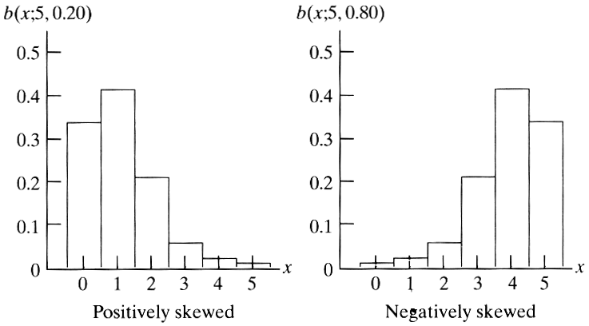
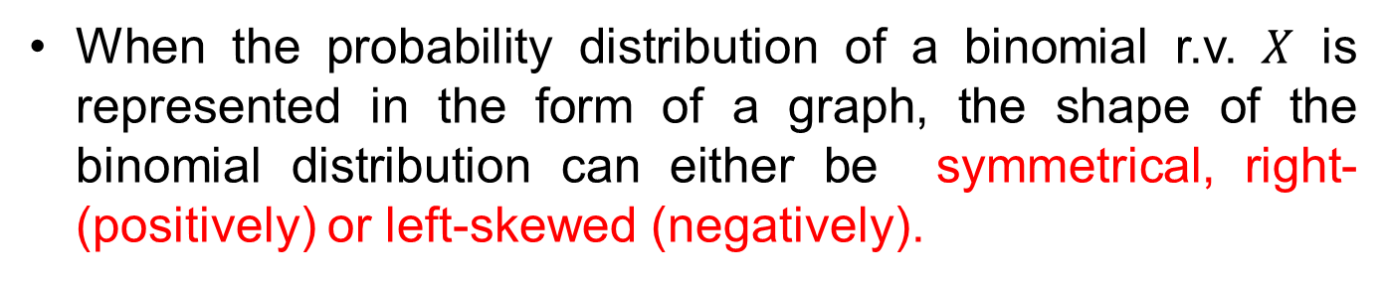
Shape of Binomial Distribution Graph
When the probability distribution of a binomial r.v. $X$ is represented in the form of a graph, the shape of the binomial distribution can either be symmetrical, right- (positively) or left-skewed (negatively).
P(X=x)
P(X=x)
Right-skewed
Left-skewed

Slide 15
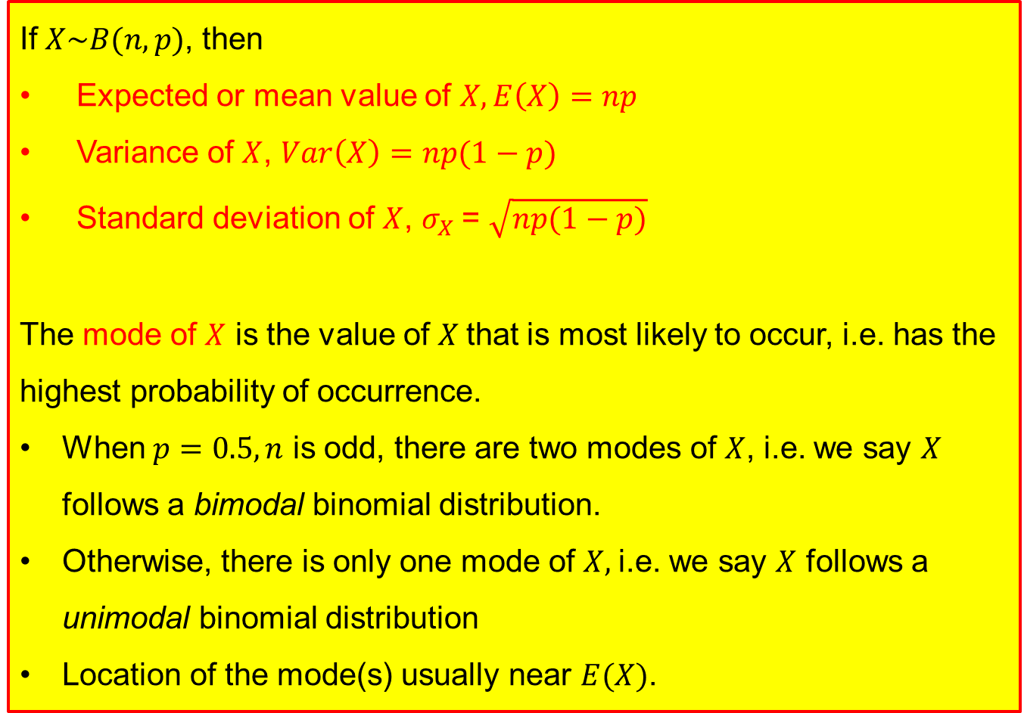
Mean, Variance, Standard Deviation, Mode of Binomial Random Variable
If $X\sim B(n,p)$, then
Expected or mean value of $X, E\left(X\right)=np$
Variance of $X$, $Var\left(X\right)=np(1−p)$
Standard deviation of $X$, $σ_{X}$= $\sqrt{np(1−p)}$
The mode of $X$ is the value of $X$that is most likely to occur, i.e. has the highest probability of occurrence.
When $p=0.5, n$ is odd, there are two modes of $X$, i.e. we say $X$ follows a bimodal binomial distribution.
Otherwise, there is only one mode of $X,$i.e. we say $X$ follows a unimodal binomial distribution
Location of the mode(s) usually near $E(X)$.

Slide 16
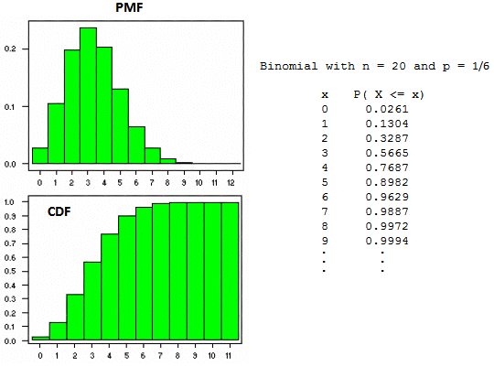
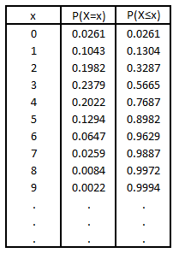

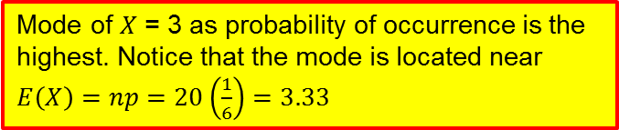


Example 7 – PMF and CDF for Binomial Distribution
Plot the PMF and CDF for a Binomial distribution with n = 20 and p = 1/6:
Mode of $X$ = 3 as probability of occurrence is the highest. Notice that the mode is located near $E\left(X\right)=np=20\left(\frac{1}{6}\right)=3.33$
$$P(X=x)$$
$$x$$
$$P(X≤x)$$
$$x$$

Slide 17
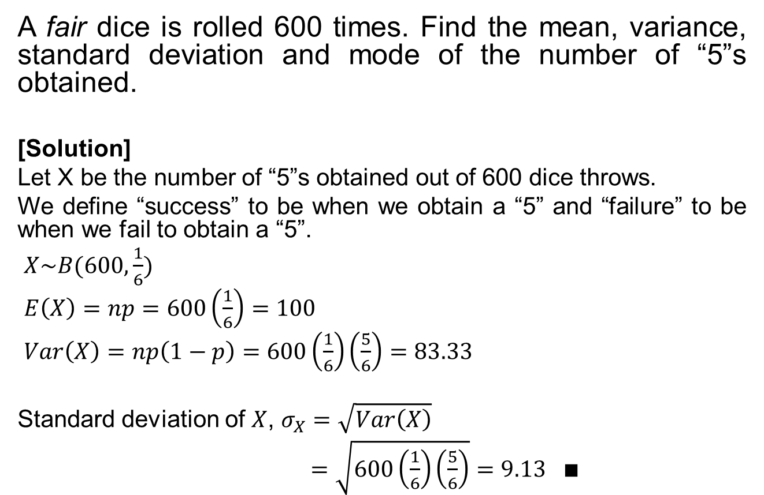
Example 8
A fair dice is rolled 600 times. Find the mean, variance, standard deviation and mode of the number of “5”s obtained.
[Solution]
Let X be the number of “5”s obtained out of 600 dice throws.
We define “success” to be when we obtain a “5” and “failure” to be when we fail to obtain a “5”.
$X\sim B(600, \frac{1}{6})$
$E\left(X\right)=np=600\left(\frac{1}{6}\right)=100$
$Var\left(X\right)=np\left(1−p\right)=600\left(\frac{1}{6}\right)\left(\frac{5}{6}\right)=83.33$
Standard deviation of $X$, $σ_{X}=\sqrt{Var\left(X\right)}$
$=\sqrt{600\left(\frac{1}{6}\right)\left(\frac{5}{6}\right)}=9.13 ∎$
Problem Solving Framework
Define the random variable in the problem context
State the distribution, with parameter values.
Solve the problem.

Slide 18
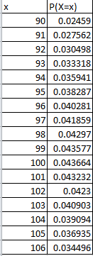
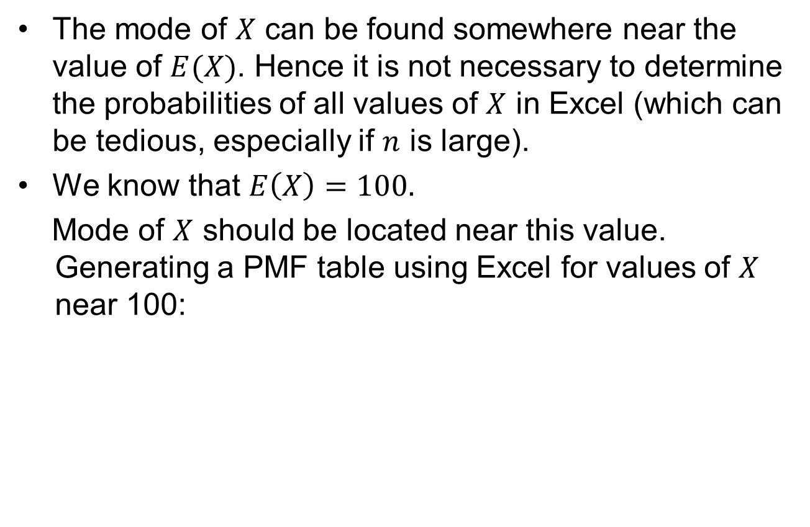
Example 8
The mode of $X$ can be found somewhere near the value of $E(X)$. Hence it is not necessary to determine the probabilities of all values of $X$ in Excel (which can be tedious, especially if $n$ is large).
We know that $E\left(X\right)=100.$
Mode of $X$ should be located near this value. Generating a PMF table using Excel for values of $X$ near 100:
Hence, mode of X = 100.

Slide 19
Learning Objectives
Apply combination formulae in calculating the number of combinations for selection of r objects out of n distinct objects
Calculate probability using combination formulae
Define a binomial random variable
Describe the characteristics and properties of a binomial distribution
Apply binomial distribution model to calculate probabilities
Calculate the mean, variance and standard deviation of a binomial random variable

Slide 20
E-Learning Video
You are strongly encouraged to watch the e-learning video prepared for L04 to enhance your understanding of the main learning objectives.
You can access the e-learning video from the following link:
https://drive.google.com/file/d/0B0VVo-P5cYtqVTRpRXVoak96WWs/edit?usp=sharing

